Slide 1
Social Network Analysis
Team members:
Harshita Singh (01FB15ECS123)
Likhita Navali (01FB15ECS156)
(UE15CS424)
Title: Twitter and Facebook Network Analysis

Slide 2
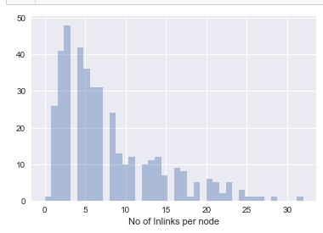
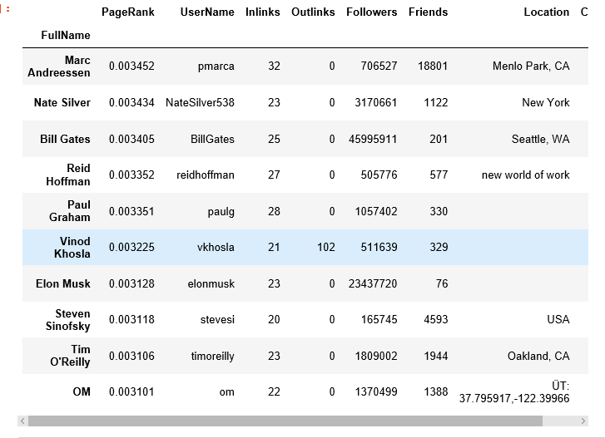
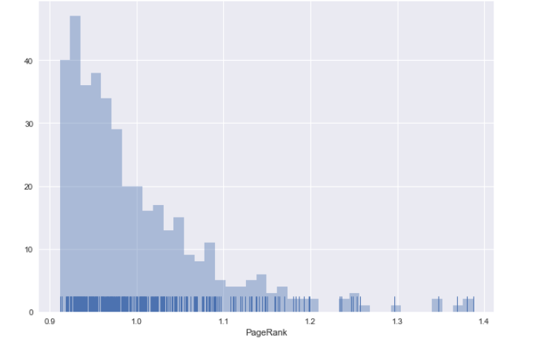
Part1: Twitter network analysis based on followers
The features implemented in this project:
Extract the ego-network of ‘self’ using Twitter API
Identify the influential nodes using ‘Pagerank’ formulation
Identify implicit clusters formed.
Recommend new friends to follow on the basis of influential
nodes in cluster of interest

Slide 3
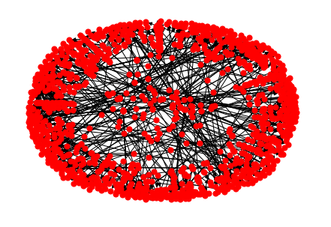
Part 2 : Twitter Network analysis based on interactions
-Tweets are fetched through the twitter api. These tweets are used for analysis.
-A directed graph is constructed.The edges represent the interactions between two nodes where nodes are users.
-Interactions between users is represented in the form of ‘retweets’ and ‘mentions’
-All analysis like measuring the betweenness centrality,
degree centrality, finding sub communities are done.
- The figure represents the ego network of the twitter
dataset.
Notes:
I.e., If a user retweets another user’s tweet, or mentions a user’s twitter handle in his tweet, an edge is introduced between the users.

Slide 4
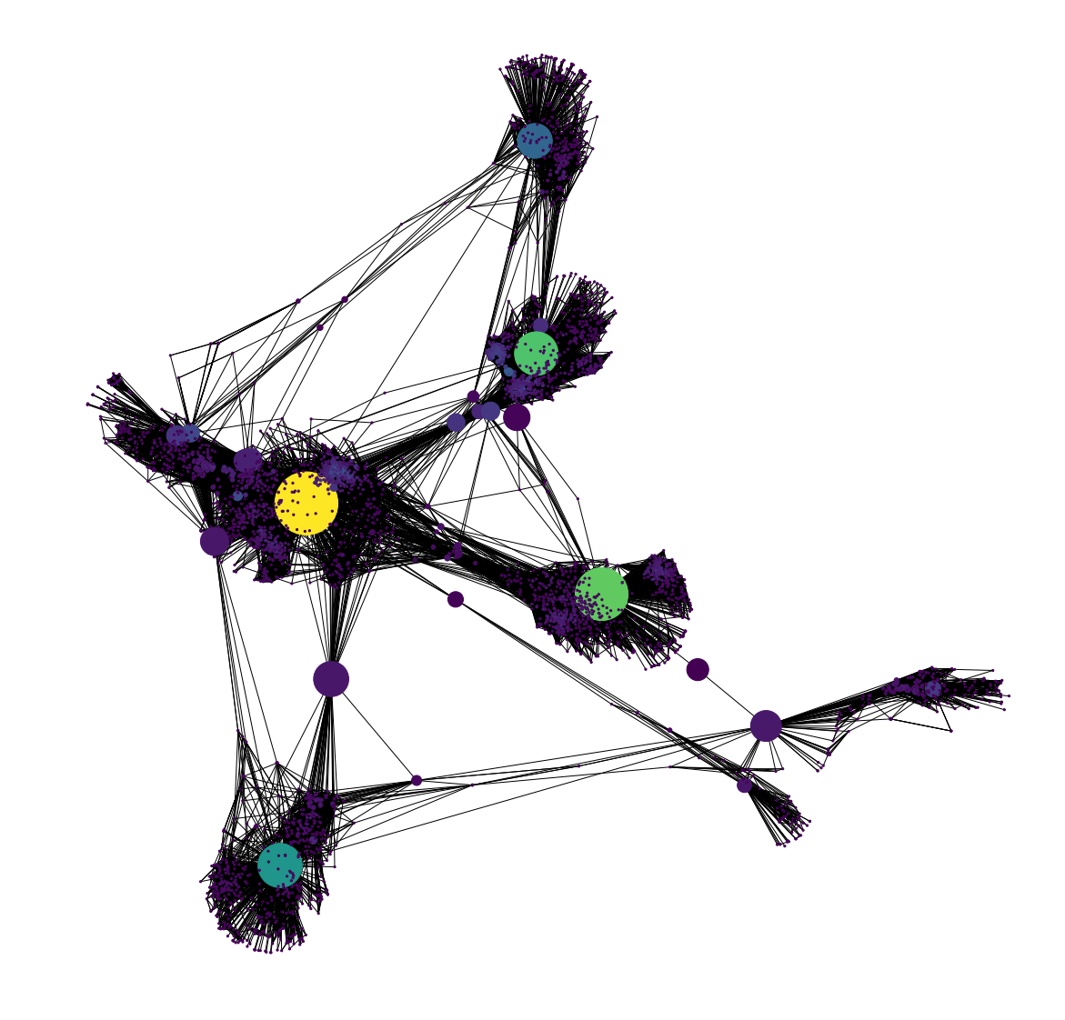
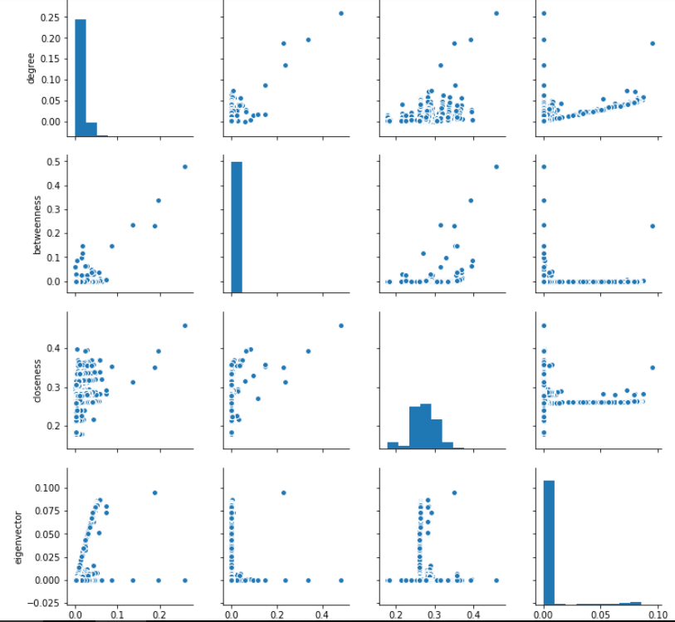
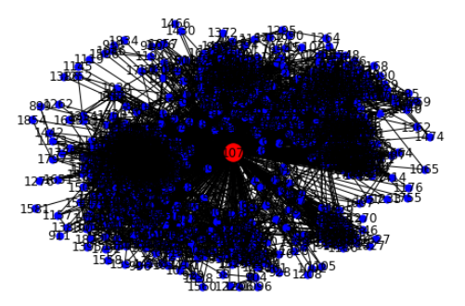
Part3: Facebook network analysis
-We used the facebook dataset. It contains the aggregated network of ten individuals’ Facebook friends list.
-Analysis is made on this data.
1.Ego network
2.Betweenness centrality network
3.Sub communities

